Slide 1
Preliminaries and motivations

Slide 2
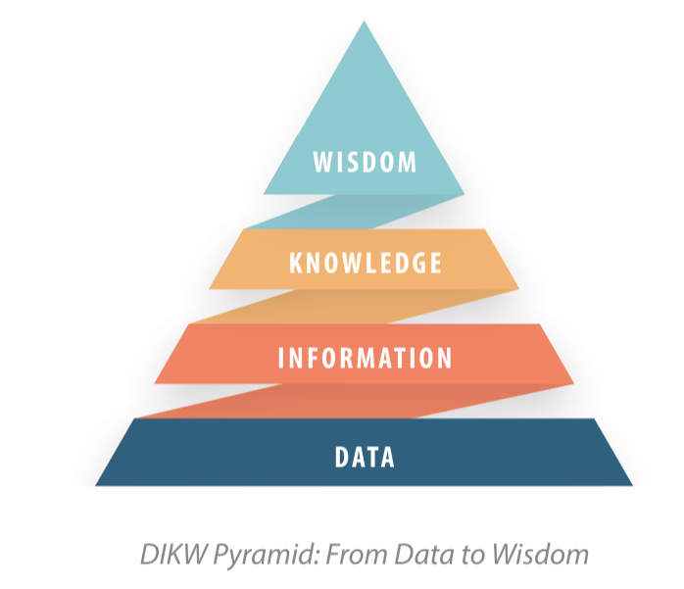
What does Knowledge mean?
Data: raw facts or values, without interpretation.
Information: the outcome of data processing and context/meaning retrieval.
Knowledge: the outcome of understanding information
Wisdom: the applied understanding and insight gained from knowledge, allowing for well-informed decisions and effective action

Slide 3
Data: raw facts or values, without interpretation.
            "Catania", "Sicily", "Italy"
Information: the outcome of data processing and context/meaning retrieval.
Catania is in Sicily, Sicily is in Italy
Knowledge: the outcome of understanding information
Catania is a town located in Sicily which is a region of Italy
        Catania -> located_in -> Sicily
        Sicily -> region _of -> Italy
        Sicily -> located_in -> Italy
        Catania-> located_in-> Italy
Wisdom: the applied understanding and insight gained from knowledge, allowing for well-informed decisions and effective action

Slide 4
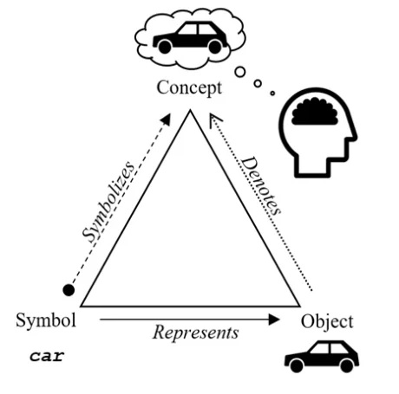
Reference
Referent
Knowledge and Meaning

Slide 5
knowledge is power
A system exhibits intelligent understanding and action at a high level of competence primarily because of the specific knowledge that it contains about its domain of endeavor. (Lenat and Feigenbaum , On the threesholds of knowledge, 1987).
The problem is how to represent knowledge and how to work with it to solve problems (modeling, representation, and reasoning).

Slide 6
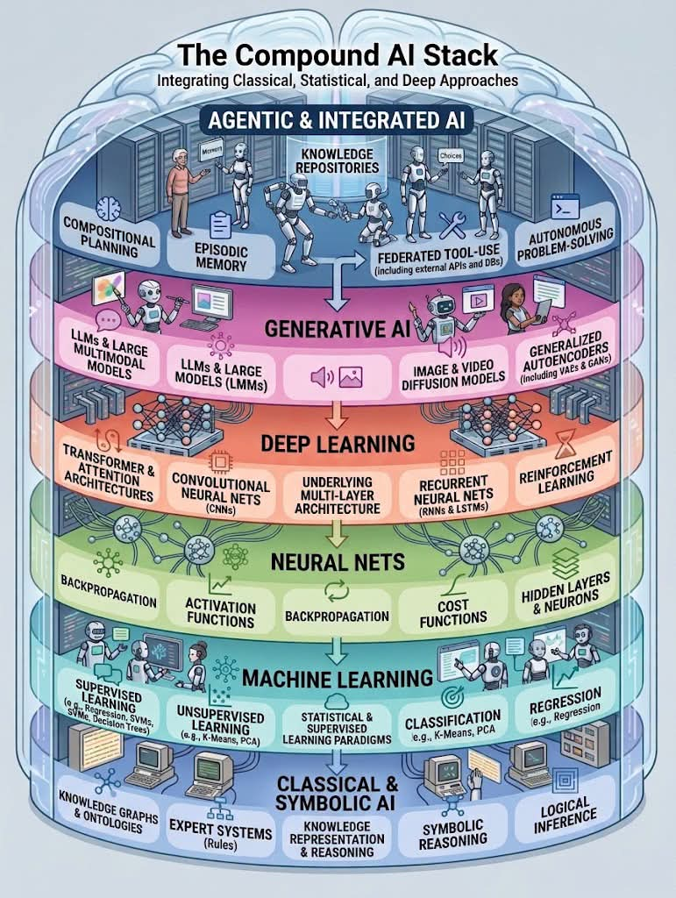
Why this course?
Knowledge provides AI with representation of entities, relationships, and facts that can be used to "reason".

Slide 7
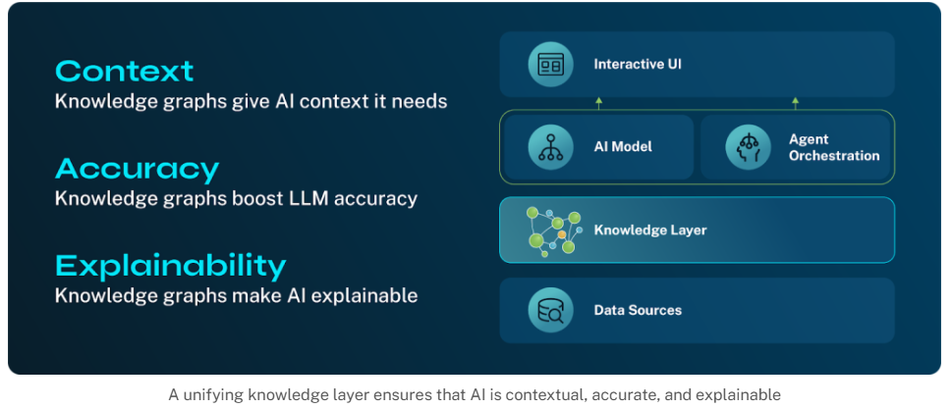
Why this course?
The knowledge layer provides the reasoning and context AI agents need

Slide 8
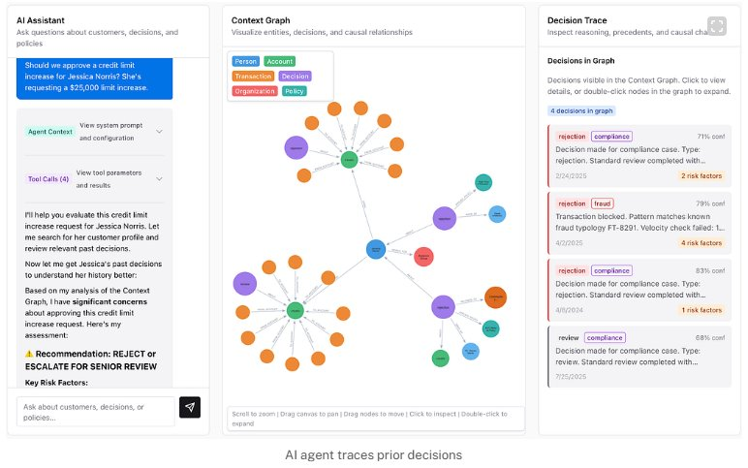
Why this course?
Example: Loan office.
A request for a $25,000 credit line increase is denied:
How past loan decisions influenced the recommendation?
What policies were applied?
If the recommendation is wrong, what caused the mistake?
We want to understand the decision history and (relevant) causal relationships relevant

Slide 9
Why this course?
Increase productivity:
Gilead Sciences implemented a knowledge layer and improved fraud detection by 1000x.
            (https://neo4j.com/customer-stories/gilead/)
  Prescription and claims activity
  Pharmacy and prescriber records
  Program utilization data
  Geographic and temporal indicators
“These data sets weren’t built to talk to each other. You can learn something from each one independently, but the real insight comes from understanding how they relate.”
"When analyzed in isolation, these datasets may obscure broader relationship patterns that are critical to understanding complex activity and supporting investigative decision‑making."

Slide 10
Why this course?
Cut costs: Media Group used a knowledge layer with its AI engine to target ads more precisely and reduced ad costs by 33%.
(https://neo4j.com/customer-stories/whatifmediagroup/)
“We’re moving beyond the era of mass marketing to one of individual understanding. The challenge isn’t just knowing what someone clicked—it’s understanding why they clicked it and what they might need next.”

Slide 11
Why this course?
Accelerate time to value: Arhasi.AI agents (knowledge graph based) delivered a 370% ROI for a US asset management firm and reducing compliance monitoring from 6 months to 6 weeks.
(https://neo4j.com/customer-stories/arhasi/)
"The client had tried vector databases to power AI agents. But vectors only store semantic similarity. They can tell you two documents look alike, but they cannot trace the logical path of a transaction or prove why a specific risk alert was triggered"

Slide 12
Why this course?
Knowledge Graphs provide a structured representation of knowledge.
Knowledge Graphs support AI systems in:
  identifying relevant entities;
  understanding relationships between concepts;
  providing contextual information;
  connecting information from different sources;
  interpreting complex queries.
  reducing unsupported or inconsistent answers;
  improving information retrieval;
  verifying and explaining IA output.

Slide 13
Why this course?
Knowledge Graphs provide semantic layer.
Knowledge Graphs support reasoning.
Knowledge Graphs support a wide range of AI applications:
  Search engines
  Recommendation systems
  Virtual assistants
  Question answering
  Semantic search

Slide 14
Why this course?
Knowledge Graphs can complement Large Language Models (LLMs).
  understanding natural language;
  generating text;
  summarizing information;
  interacting with users.
  Knowledge Graphs do not automatically eliminate AI errors or hallucinations.

Slide 15
Why this course?
- Mapping Planetary Biodiversity
- Making Space Travel Safer
- Curing Rare Childhood Diseases
- Exposing Global Corruption
- Increasing Crop Yields
- Controlling Hospital Infections
- Safeguarding Democracy
- Facilitating Drug Discovery
- Tracking Pandemics
- Improving Diabetes Treatment

